Slide 1
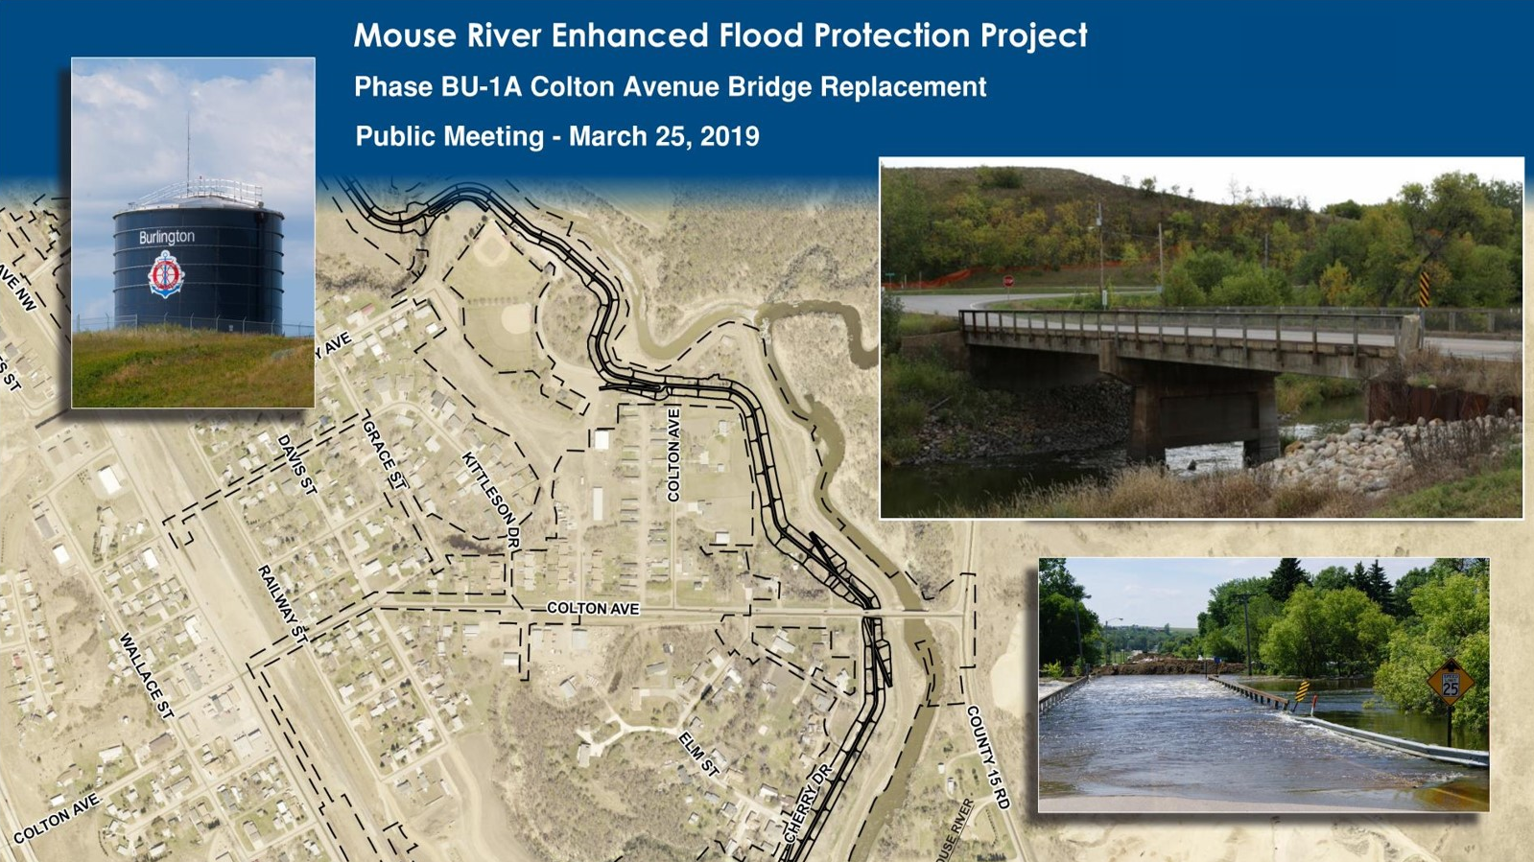
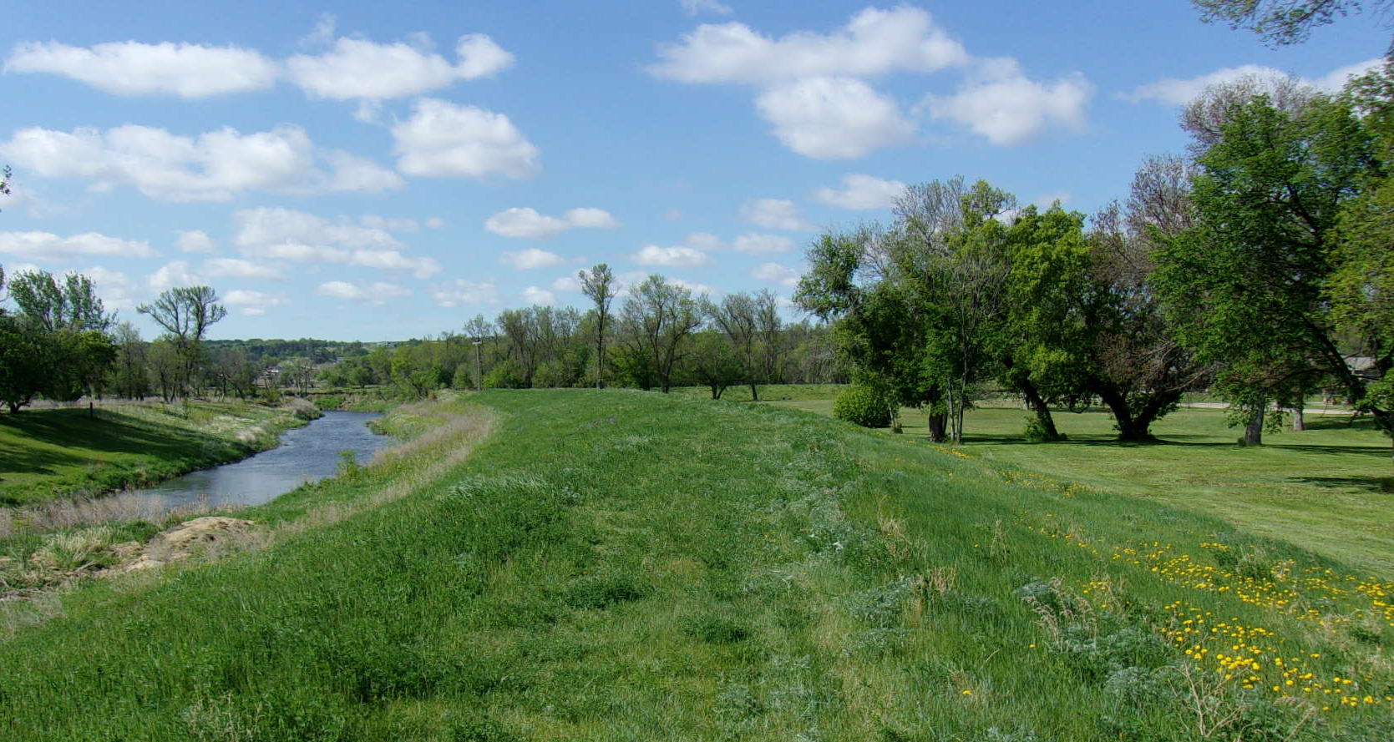



Mouse River Enhanced Flood Protection Project
Phase BU-1D Burlington
Public Meeting

Slide 2



Introduction
  Owner: Souris River Joint Water Resource Board
    Dave Ashley, Chairman
  Owner’s Representative Team
    Dan Jonasson, Director of Public Works
    Ryan Ackerman, SRJB
    Jason Westbrock, Barr
  Engineering Team:
    Mark Kretschmer, Barr
    Patrick Samson, Ackerman-Estvold
    Aaron Fornshell, Ackerman Estvold
  Contractor:
    Leif Anderson, Blue Stone Construction, Inc

Slide 3
Project Description
BU-1A
COLTON AVE BRIDGE
BU-1C
REC FACILITY
BU-1B SOUTH LEVEE
BU-1D
PARK ROAD

Slide 4
Phase BU-1C
PATH ON COLTON
PAVING OF LEVEE TRAIL
PAVING OF PARKING LOT
CONSTRUCT GRAVEL LOT

Slide 5
Phase BU-1D
OLD SETTLERS PARK
BANK STABILIZATION
ELEVATE PARK ROAD 6 FEET
CHURCH PARKING LOT

Slide 6
Phase BU-1D

Slide 7
Construction Sequencing
Notes:
Construction Milestones have been included in the Summary of Work Section 01 11 00 of the Project Manual. We have developed an overall project schedule which includes input from multiple stake holders (Project Owner, Project Sponsor, Golf Course, others)….AND at the same time trying to allow the Contractor as much flexibility to properly sequence the overall project (not always an easy task!)
I’m going to focus on several key project elements which drive the overall sequence.

Slide 8
Traffic Control
Notes:
Construction Milestones have been included in the Summary of Work Section 01 11 00 of the Project Manual. We have developed an overall project schedule which includes input from multiple stake holders (Project Owner, Project Sponsor, Golf Course, others)….AND at the same time trying to allow the Contractor as much flexibility to properly sequence the overall project (not always an easy task!)
I’m going to focus on several key project elements which drive the overall sequence.

Slide 9
Mouse River Enhanced Flood Protection Project
Phase BU-1D Burlington
Questions?

