Slide 1
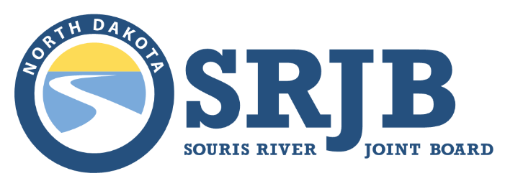
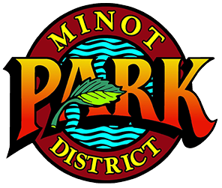
Phase mi-7: Roosevelt park levee
Public information meeting
May 4th, 2022

Slide 2
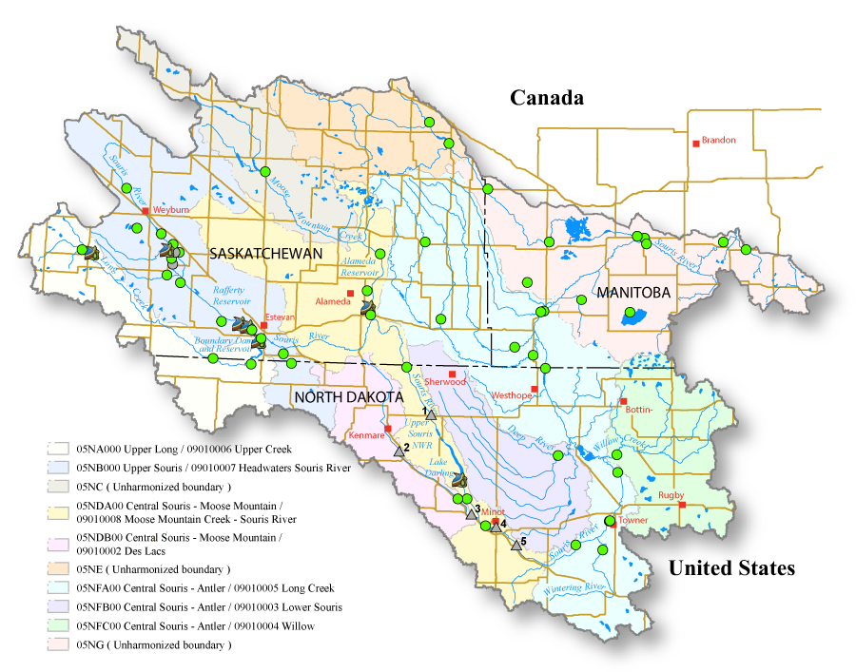
International Watershed
Heavily Regulated
Rafferty Reservoir on Souris (Mouse) River near Estevan, SK
Alameda Reservoir on Moose Mountain Creek near Oxbow, SK
Boundary Reservoir on Long Creek near Estevan, SK
Lake Darling Reservoir on Mouse (Souris) River near Burlington, ND
Headwaters in Saskatchewan
Flows Through Northern North Dakota
Confluence with Assiniboine River in Manitoba
Prairie Pothole Region with Volatile Hydrology

Slide 3
Mouse River Historical Flooding
1881 – 22,000 cfs
1904 – 12,000 cfs
1916 – 4,300 cfs
1927 – 3,900 cfs
1969 – 6,000 cfs
1975 – 5,700 cfs
1976 – 9,400 cfs
1979 – 6,000 cfs
2011 – 27,400 cfs
Damage Threshold
(Flows Above this Cause Significant Damage)
1970s Channelization Increased Conveyance Capacity
2011 Flood
(>5x Capacity)

Slide 5
Minot Damages Alone
4,100 homes were flooded
3,100 homes extensively damaged or lost
1 in 10 homes with flood insurance
11,000+ individuals displaced
6 Minot public schools severely damaged
2 schools complete losses
1,200 students displaced
200+ businesses damaged
51 park buildings damaged
5 baseball fields damaged
29 zoo buildings damaged
Roosevelt pool and bathhouse lost
Oak Park splash pad and mechanical building lost
12 churches damaged
20 + water system breaks
12 of 27 sanitary lift stations inundated with water
13 (all) water wells inundated with water
6 river pump stations damaged
30 to 40 sink holes from ground water
3 pedestrian bridges damaged
2 highway/street bridges damaged
277 street lights damaged
16 electrical feed points damaged
1,000 traffic signs damaged
51 miles of roads, sewer and water lines damaged
33 miles of storm sewers damaged

Slide 6
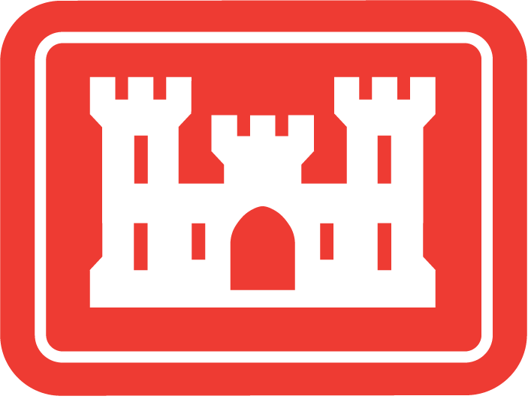
Parallel Efforts to Reduce Flood Risk
Regional
Federal
International
Local
Mouse River Enhanced Flood Protection Project
(SRJB / State / Local)
Maple Diversion
Phase of MREFPP
(USACE / SRJB)
Plan of Study to Modify Reservoir Operations
(IJC / ISRB)
National Disaster Resilience Competition Activities
(Minot)
Reduced Flood Risk for Mouse River Residents Basin-Wide

Slide 7
Parallel Efforts to Reduce Flood Risk
Regional
Federal
International
Local
Mouse River Enhanced Flood Protection Project
(SRJB / State / Local)
Maple Diversion
Phase of MREFPP
(USACE / SRJB)
Plan of Study to Modify Reservoir Operations
(IJC / ISRB)
National Disaster Resilience Competition Activities
(Minot)
Reduced Flood Risk for Mouse River Residents Basin-Wide

Slide 8
Future FEMA Regulatory Floodplain

Slide 9
MI – 2
NAPA VALLEY LEVEE ($35 M)
US HWY 83 IMPROVEMENTS
($1 M)
MI – 3
FOREST ROAD LEVEE ($10 M)
PERKETT DITCH
IMPROVEMENTS
($4 M)
MI – 1
4TH AVENUE NE FLOODWALL
($45 M)
WATER TREATMENT PLANT FLOODWALL ($30 M)
US HWY 83 BYPASS IMPROVEMENTS
($2 M)
WC-1
TIERRECITA VALLEJO
LEVEE ($20M)
Phases Complete or in Construction

Slide 10
MI – 5
NORTHEAST TIEBACK FLOODWALL
($64 M)
~100% DESIGNED
~100% ACQUIRED
CONSTRUCTION WILL BEGIN SPRING 2022
$9.8 M FEDERAL FUNDS AWARDED SEPTEMBER 2021
MI – 4
MAPLE DIVERSION
($95 M)
~50% DESIGNED
~99% ACQUIRED
CONSTRUCTION PLANNED TO BEGIN SPRING 2024
$61.5 M FEDERAL FUNDS AWARDED JANUARY 2022
Current Minot Design & Acquisition Focus

Slide 11
REMOVES APPROX. 60% OF MINOT RESIDENTS FROM THE FEMA REGULATORY FLOODPLAIN
Interim Regulatory Floodplain Following Milestone 1

Slide 12
PHASE MI-7: ROOSEVELT PARK LEVEE
PHASE MI-6: DOWNTOWN
LEVEE
PHASE MI-9: VALKER ROAD LEVEE
PHASE MI-8: BURDICK EXPRESSWAY BRIDGE REPLACEMENT
DETAILED DESIGN AUTHORIZED SPRING 2021
Future Focus – Minot Milestone 2

Slide 13
REMOVES AN ADDITIONAL APPROX. 15% OF MINOT RESIDENTS FROM THE FEMA REGULATORY FLOODPLAIN
Interim Regulatory Floodplain Following Milestone 2

Slide 14
NORTH ROOSEVELT PARK LEVEE
NORTH VALKER ROAD LEVEE
27TH STREET DIVERSION
KELLER
LEVEE
Long Term Future Focus – Minot Milestone 3

Slide 15
REMOVES REMAINING APPROX. 25% OF MINOT RESIDENTS FROM THE FEMA REGULATORY FLOODPLAIN
Future Regulatory Floodplain Following Milestone 3

Slide 16
PHASE MI-7: ROOSEVELT PARK LEVEE
PHASE MI-6: DOWNTOWN
LEVEE
PHASE MI-9: VALKER ROAD LEVEE
PHASE MI-8: BURDICK EXPRESSWAY BRIDGE REPLACEMENT
DETAILED DESIGN AUTHORIZED SPRING 2021
Future Focus – Minot Milestone 2

Slide 17
Phase MI-6: Downtown Levee
30% Design Complete April 2022
Public Input Meetings Planned May 23 or 24, 2022

Slide 18
Phase MI-7: Roosevelt Park Levee
30% Design Completed March 2022

Slide 19
Phase MI-7: Roosevelt Park Floodwall / Levee
Phase MI-7:
Roosevelt Park Levee
North section is primarily levee
Limited impacts to swimming pool, skate park, or tennis courts
New stormwater pump station as part of Phase MI-6
Relocated Teddy Roosevelt statue
Relocated Magic City Express facilities (building, loading platform, tracks)
Reconfigured access and parking
Reconstructed bathroom facility / relocated shelters
Relocated pedestrian bridge from zoo (location expected to shift)
Relocated fishing pier (location expected to shift)

Slide 20
Phase MI-7: Roosevelt Park Levee
South section is primarily floodwall
Relocated North American / Children’s Zoo exhibits from north side of river to current park area between zoo and swimming pool
Relocated Magic City Express
Access control
Accommodating future zoo master plan with new exhibits / features
SRJB-funded construction
Zoo-funded construction
Continuous pedestrian pathways along the greenway

Slide 21
Phase MI-7: Roosevelt Park Levee Anticipated Challenges
Highly-Sequenced Construction Will Likely Last 3 Years (Estimated 2025-2027)
Construction Noise Impacts to Residents / Zoo
Dust
Temporary Closure of Roosevelt Park Features
Not a complete closure
Maintain access to pool, tennis courts, most of zoo during most periods of construction
Change in location of open space
Current Roosevelt Park becomes relocated zoo exhibits
New open space on north / east side of river currently occupied by zoo exhibits
Connection across the river to the north / west in former residential area (Ben’s Tavern neighborhood)

Slide 22
Phase MI-7: Roosevelt Park Levee Next Steps
Gather public input
Gather agency input (City of Minot Development Review Team, US Army Corps of Engineers, National Park Service)
Design complete by mid-2023
Permitting complete by end 2023
Secure funding (State of ND, City of Minot)
Construction in 2025 +/- (depending on funding)

Slide 23
THANK YOU
Phase mi-7: Roosevelt park levee
Public information meeting
4 may 2022

