Slide 1
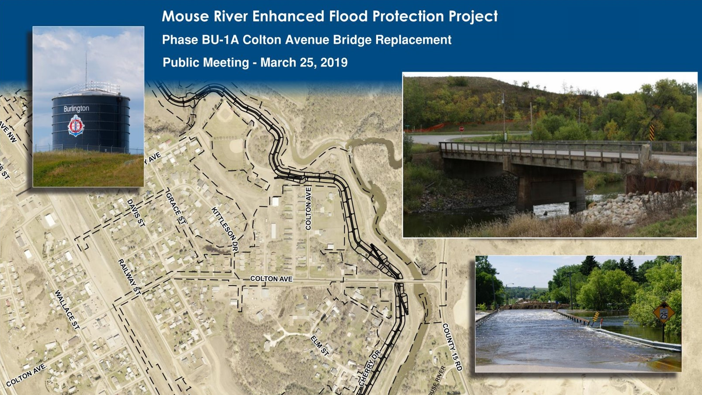
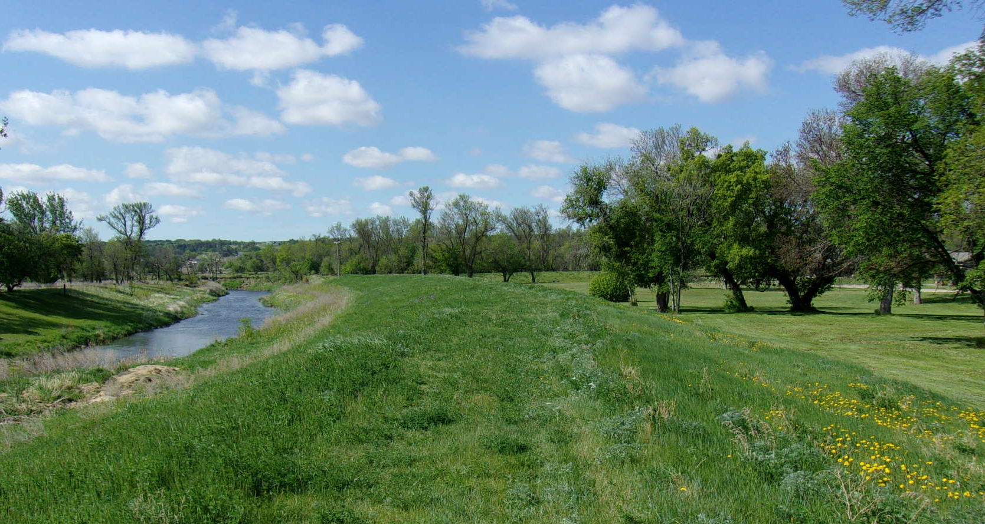



Mouse River Enhanced Flood Protection Project
Phase BU-1C Burlington
Pre-Construction Meeting

Slide 2



Introduction/Attendees
  Owner: Souris River Joint Water Resource Board
    Dave Ashley, Chairman
  Owner’s Representative Team
    Dan Jonasson, Director of Public Works
    Ryan Ackerman, SRJB
    Jason Westbrock, Barr
  Engineering Team:
    Mark Kretschmer, Barr
    Patrick Samson, Ackerman-Estvold
    Aaron Fornshell, Ackerman Estvold
  Contractor:
    Leif Anderson, Blue Stone Construction, Inc

Slide 3
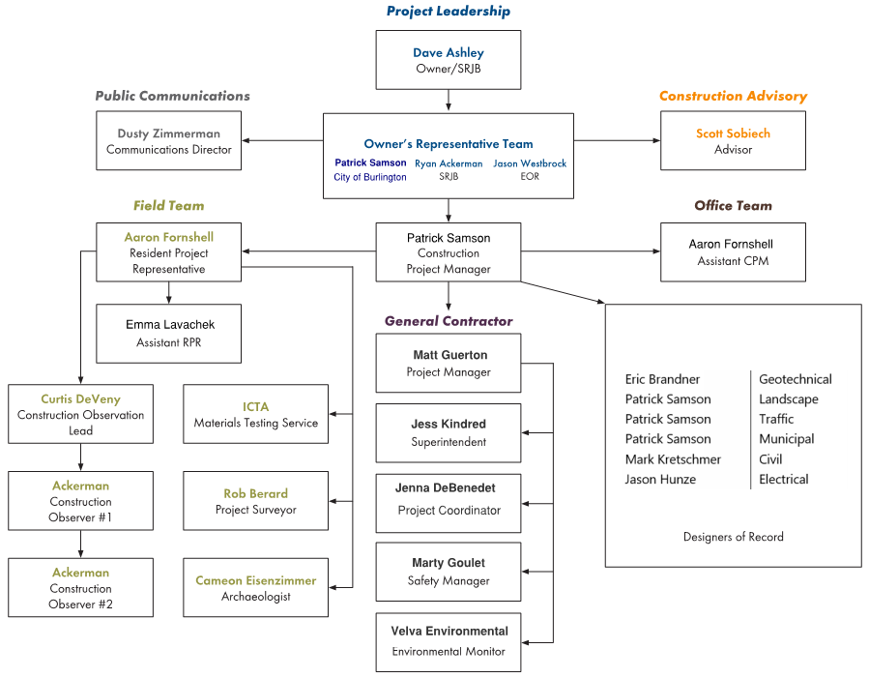
Org. Chart
Emma Lavacheck
Leif Anderson
Ron Marx
John Cole
Ryan Anderson
Architectural

Slide 4
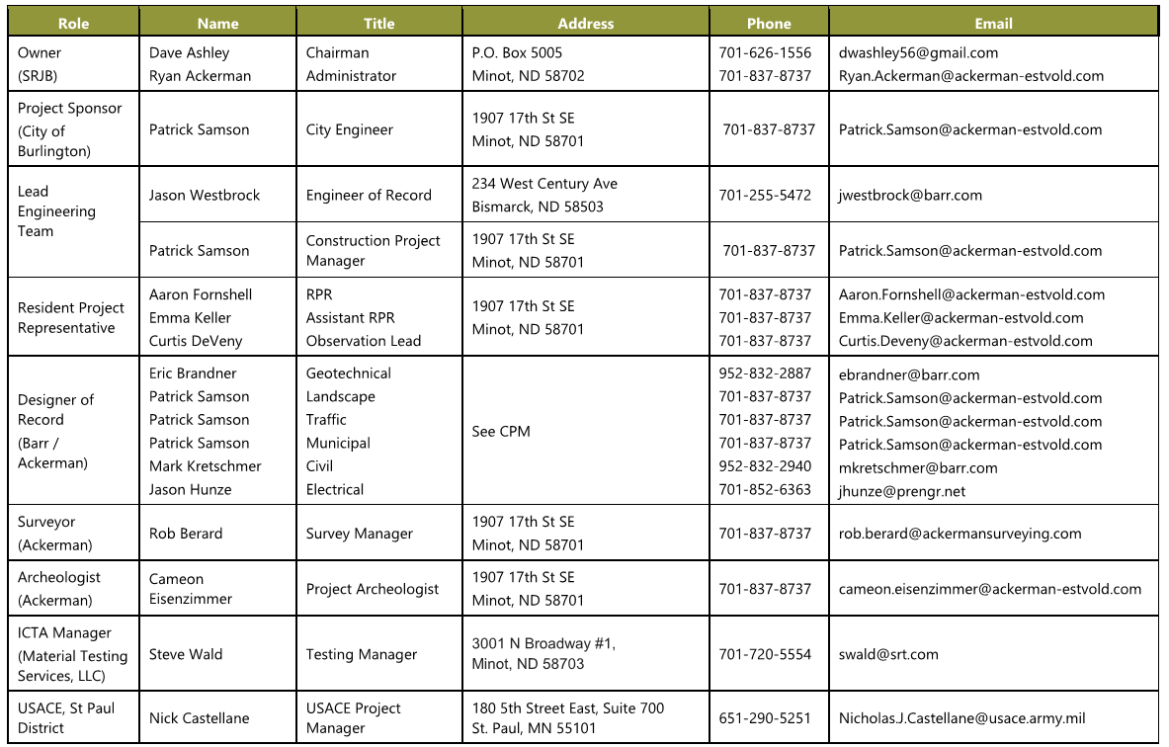
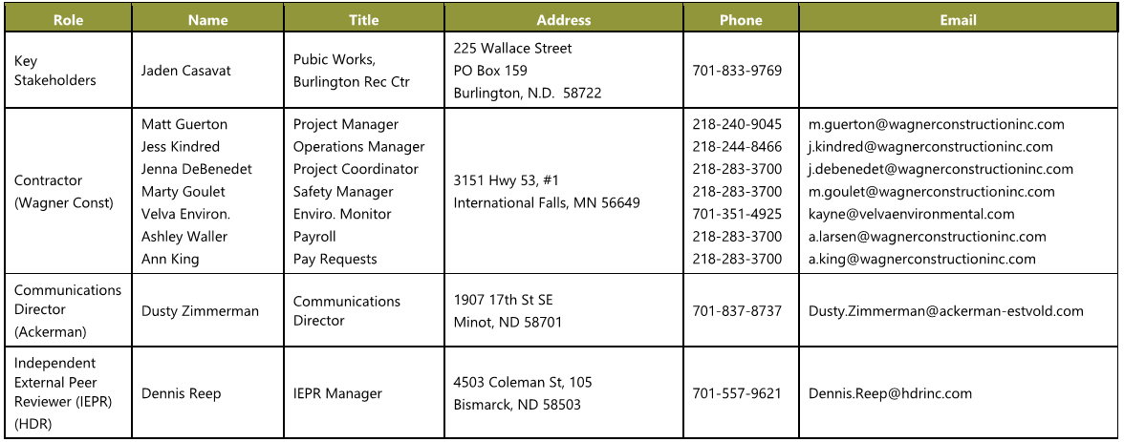
Project Directory
Ron Marx
Ron.marx@ackerman-estvold.com
Ryan Anderson
Architectural
701-837-8737
ryan.Anderson@ackerman-estvold.com
Leif Anderson
701-240-4915
leif@bluestonenodak.com
John Cole
601-754-8350
john@bluestonenodak.com
Blue Stone Construction
PO BOX 2129
Minot, ND 58702

Slide 5
Project Description
FUTURE OR BY OTHERS WORK AREA IN GRAY
EROSION PROTECTION
DRAINAGE IMPROVEMENTS & PAVING
PHASE 1C LEVEE
DRAINAGE IMPROVEMENTS
GENERAL FILL
OVERBANK EXCAVATION
DRAINAGE IMPROVEMENTS
EROSION PROTECTION
GENERAL FILL

Slide 6
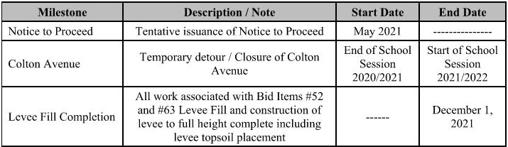
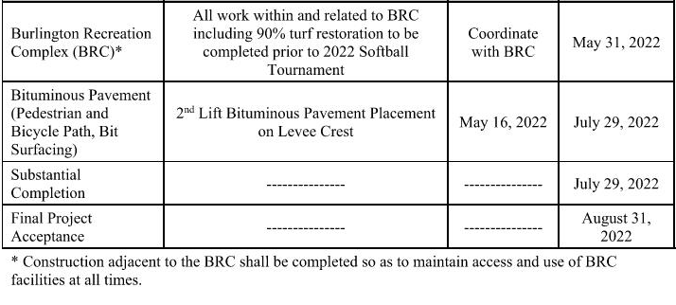
Construction Sequencing
Notes:
Construction Milestones have been included in the Summary of Work Section 01 11 00 of the Project Manual. We have developed an overall project schedule which includes input from multiple stake holders (Project Owner, Project Sponsor, Golf Course, others)….AND at the same time trying to allow the Contractor as much flexibility to properly sequence the overall project (not always an easy task!)
I’m going to focus on several key project elements which drive the overall sequence.

Slide 7
Staging and Site Access
FIELD OFFICE
STAGING AREA
Notes:
NORTH DAKOTA DOT – Coordinating work associated with the Highway 83 Bypass (west side of Phase MI-2)…which includes:
Connecting the main levee into the existing Highway embankment
Coordination with 7th Avenue Modifications
Minot Park District – Coordination related to the Dakota Bark Park
Golf Courses – Souris Valley Golf Course and Wee Links Golf Course

Slide 8
Haul Route
& Traffic Control
Notes:
Construction Milestones have been included in the Summary of Work Section 01 11 00 of the Project Manual. We have developed an overall project schedule which includes input from multiple stake holders (Project Owner, Project Sponsor, Golf Course, others)….AND at the same time trying to allow the Contractor as much flexibility to properly sequence the overall project (not always an easy task!)
I’m going to focus on several key project elements which drive the overall sequence.

Slide 9
Franchise Utilities
OVERHEAD ELECTRICAL
XCEL SERVICE AREA
VERENDRYE SERVICE AREA
OVERHEAD ELECTRICAL

Slide 10
PROPERTY NOTES
BURLINGTON RECREATION COMPLEX

Slide 11
Water Control and Maintaining Level of Protection
Project manual, Section 01 51 36 Water Control – Temporary Emergency Action Plan (TEAP)
Notes:
The Project Sponsor….City of Minot currently Operates and Maintains the existing levee system.
Phase MI-2 and 3 removes and replaces the existing flood risk management system within the project limits. The existing was originally designed to minimize flooding up to a flow rate of 5,000 cfs from the Mouse River. Removal of the existing flood risk management system needs to be sequenced as to maintain the existing level of protection to infrastructure throughout the duration of the Project.
The Project Manual Sections 01 35 29 Health and Safety, 01 51 36 Water Control…both outline requirements related to continued flood protection.
Text on slide from the project TEAP - The TEAP provides a procedure for ensuring worker and public safety in the event of an actual or impending flood conditions.
Highlight A, B and C.

Slide 12
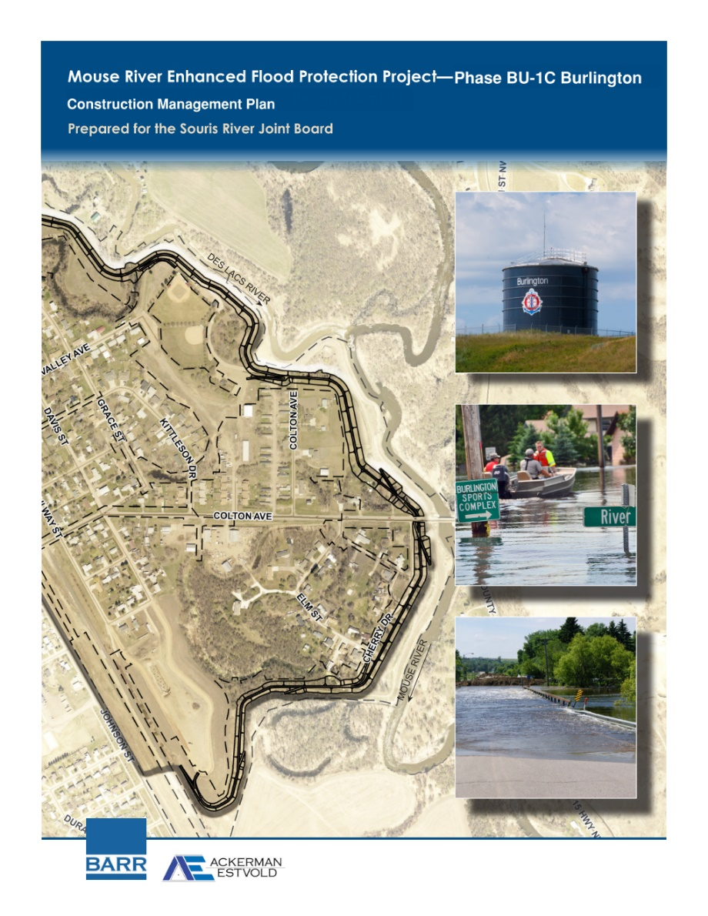
Construction Management Plan

Slide 13
Construction Surveying
Project manual, Section 01 11 00 Summary of Work:
D. Limited construction staking services will be provided by Owner. Contractor will provide a minimum of 3 working days’ notice to surveyor for construction stakes. Construction staking may also rely on Contractor’s work schedule. Contractor is responsible for assuring site is survey ready for the work required (survey work area is clear of debris, materials, stockpiles, equipment, etc.). Owner will provide the following construction staking:
          Survey Control: Northing, easting, and elevation of up to 10 survey locations selected by Contractor.
          Demolition Staking: Identify structures to be abandoned, removed, or relocated.
          Removal Areas: Stake or paint location and perimeter. Includes pavement, utilities, clearing, and levee demolition.
          Staging Areas: Stake staging areas at each vertex and every 100 feet.
          Construction Limits: Stake construction limits at each vertex and every 200 feet.
          Erosion and Sediment Control: Location of silt fencing, sediment control logs, sedimentation basins, rock filter dikes, and diversion berms.
          THROUGH………
          23. Clearing and Grubbing: Stake boundary at 100 foot intervals.

Slide 14
Inspections - Designers of Record

Slide 15
Permits – Owner Acquired
Project manual, Section 01 41 26 Permits:
      1.03 SUMMARY OF PERMITS OR APPROVALS OBTAINED BY OWNER
        The following permits have been or are in the process of being obtained by Owner:

Slide 16
Permits – Contractor Acquired
Project manual, Section 01 41 26 Permits:
      1.02 summary of permits to be obtained by contractor
        Contractor Obtained Permits: Apply for and obtain the following permits:
          Contractor shall obtain the NPDES Construction Stormwater Permit from the North Dakota Department of Environmental Quality for the Work.
          Contractor shall obtain the Building Permits from the City of Burlington Planning and Zoning Department for the Work.
          Ward County Highway Department Contractor permits for the work
          Contractor shall acquire necessary approvals from the Canadian Pacific Railroad (CP) prior to work within railroad right of way. Contractor shall notify CP in advance of any work requiring track re-setting equipment to allow time to mobilize.
          Contractor shall obtain dewatering permits, if required.

Slide 17
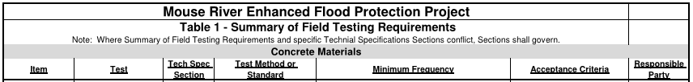
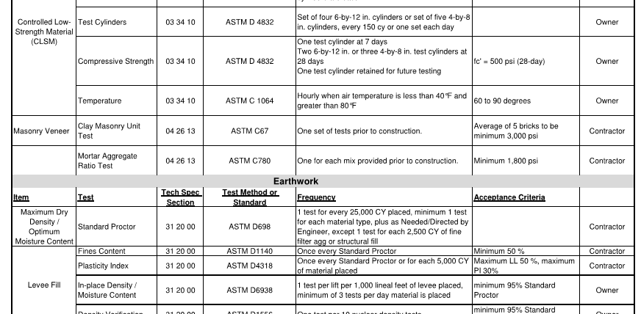
Testing
Project manual, Section 01 43 00 Quality requirements:
Notes:
Testing for the Project is defined within individual sections of the Project Manual.
There is also a Material Testing Summary for Contractor Reference in Section 01 43 00 Quality Requirements.
The Summary clearly defines who is responsible for testing between the Contractor and Owner.

Slide 18

Communications
Public Notices:
Construction Schedule / Updates
Road Closures
Utility Disruptions
Notes:
Testing for the Project is defined within individual sections of the Project Manual.
There is also a Material Testing Summary for Contractor Reference in Section 01 43 00 Quality Requirements.
The Summary clearly defines who is responsible for testing between the Contractor and Owner.

Slide 19
Mouse River Enhanced Flood Protection Project
Phase BU-1C Burlington
Questions?

